Slide 1
數位系統實驗
LAB-02
陳培殷
國立成功大學 資訊工程系

Slide 2
Outline
複習 & 接線技巧
Lab review
接線技巧
Lab 說明
Lab Notice
Lab 02-1
Lab 02-2

Slide 3
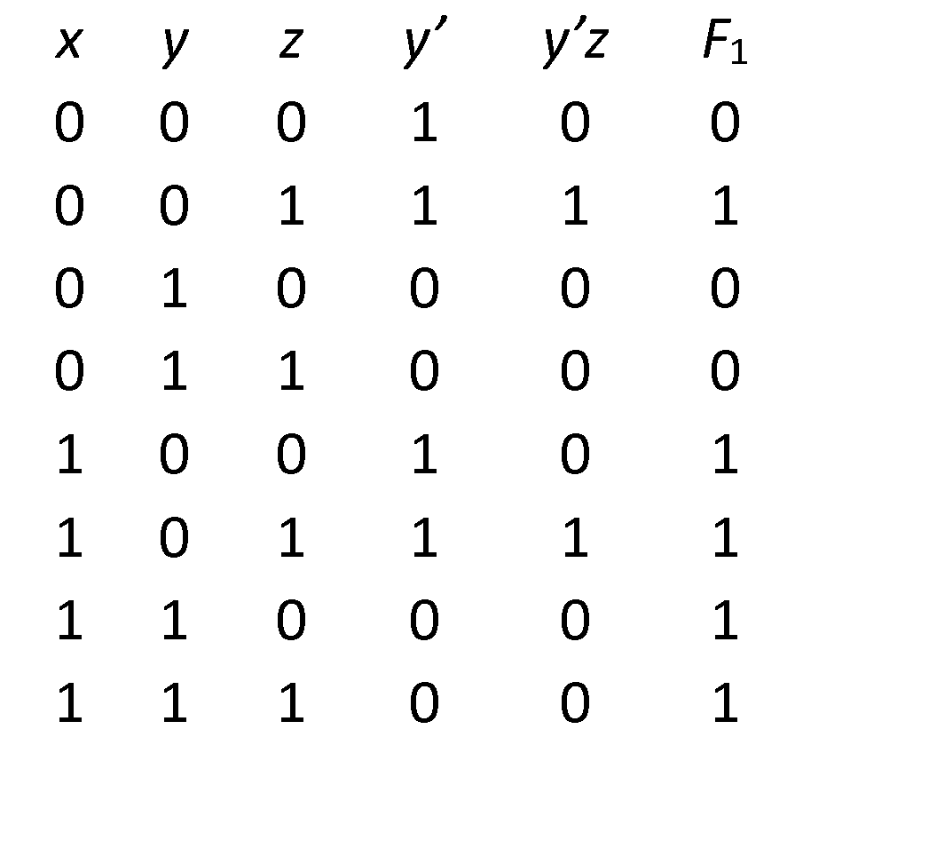
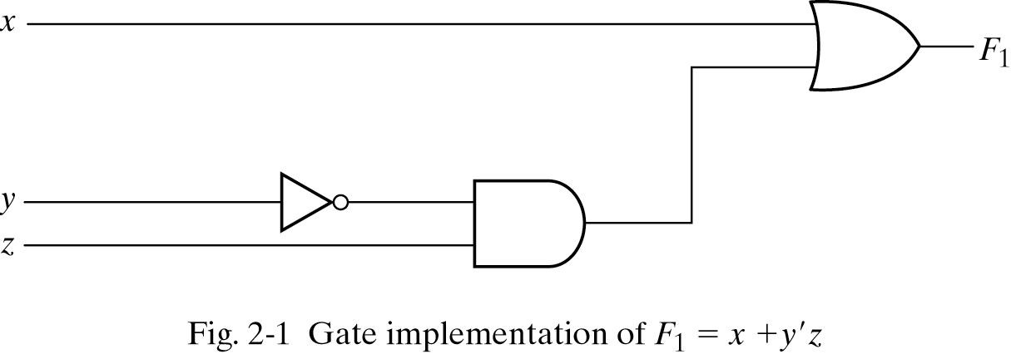
Three representations for a circuit
複習&接線技巧 - Lab Review
1. Boolean Algebra
2. Truth Table
真值表
n input variables 🡺 2^{n} combinations
F₁=x+y’z
Inputs
3. Circuit Diagram

Slide 4
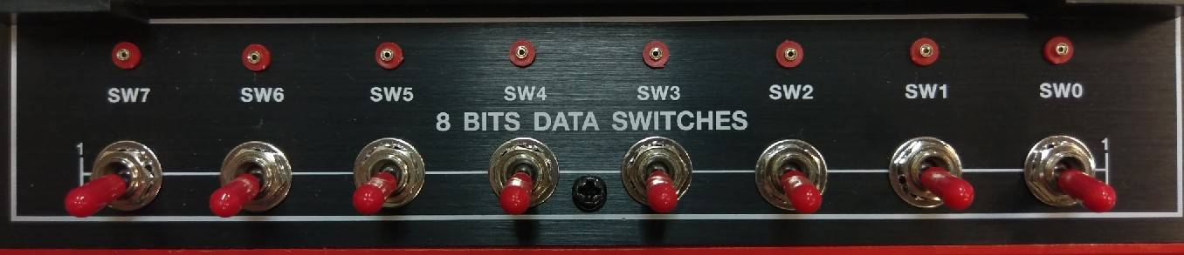
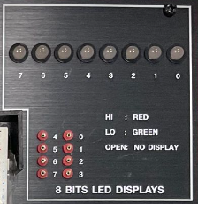
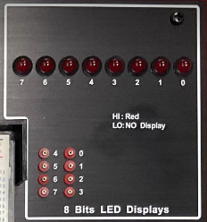
複習&接線技巧 - Lab Review
Input
Output
ETS-5000
ETS-7000A

Slide 5
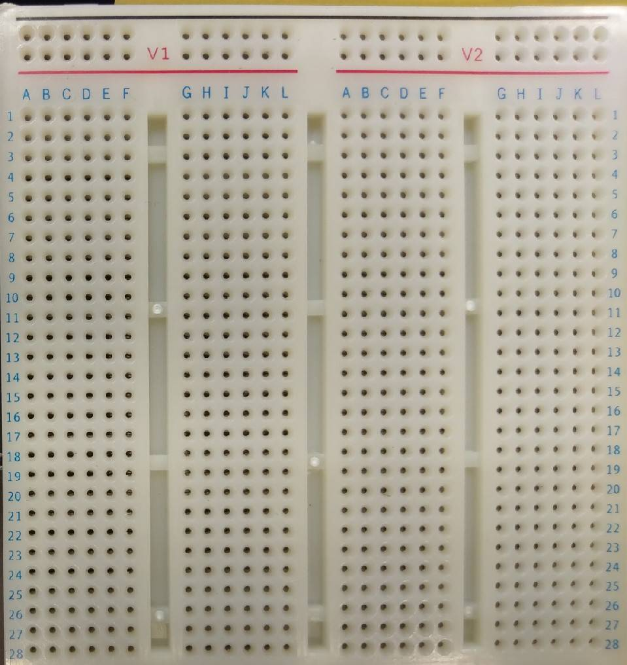
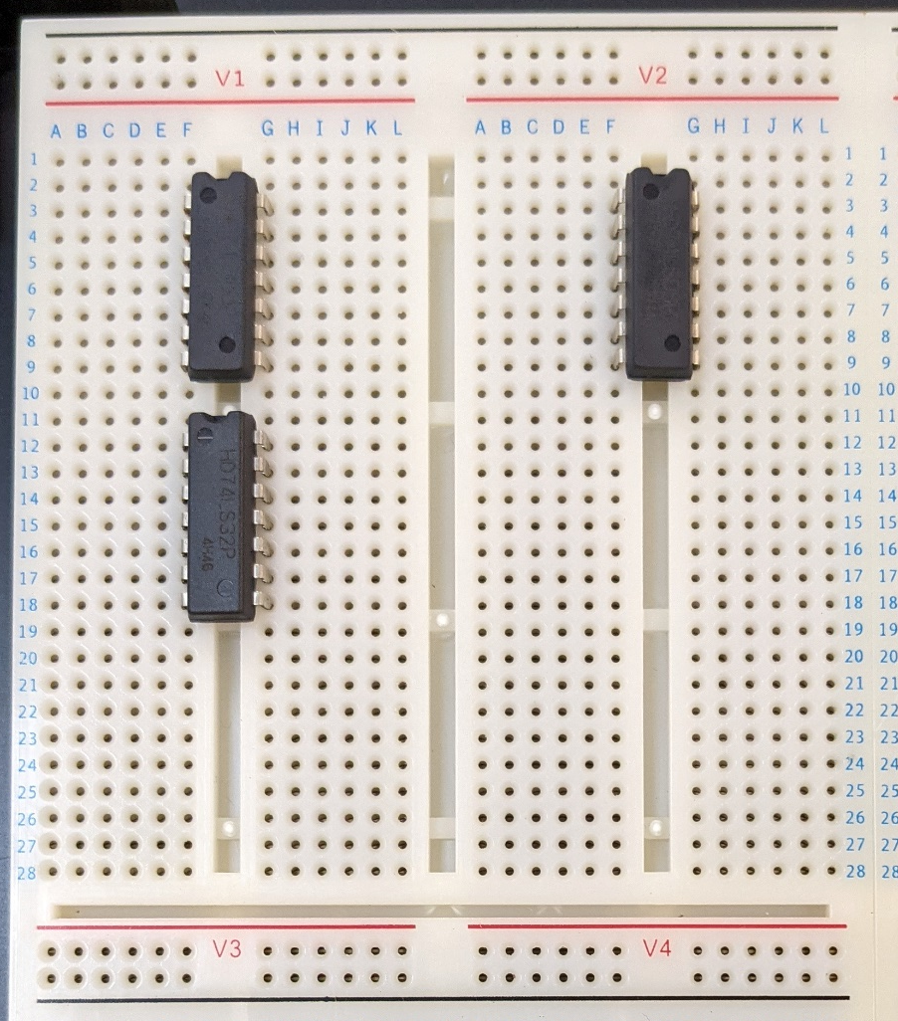
複習&接線技巧 - 接線技巧
Correct
VCC：
GND：

Slide 6
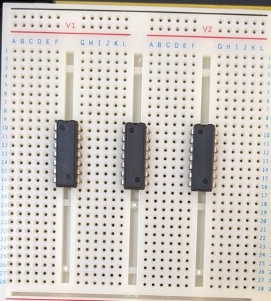
複習&接線技巧 - 接線技巧
Wrong
Overlap

Slide 7
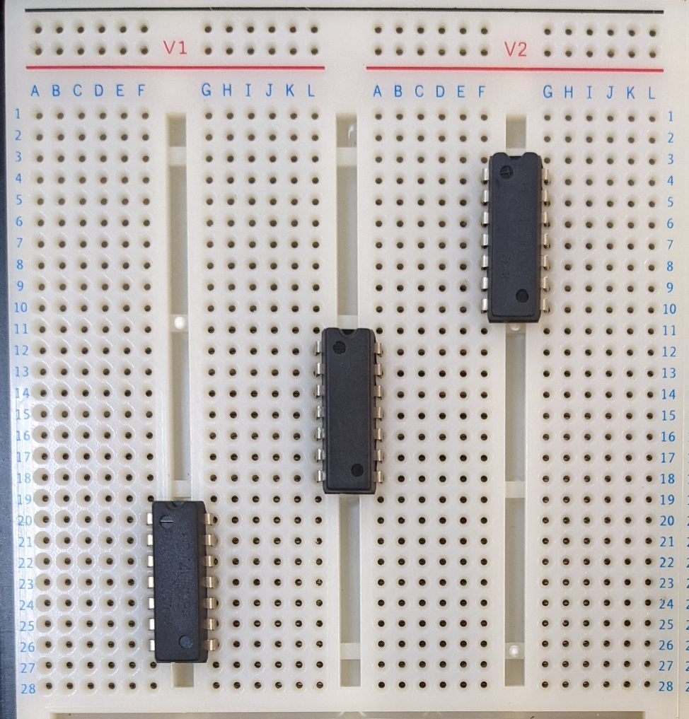
複習&接線技巧 - 接線技巧
Correct
VCC：
GND：

Slide 8
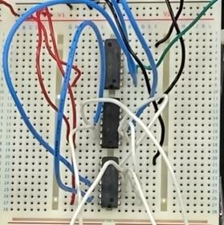
複習&接線技巧 - 接線技巧
Correct
VCC：
GND：

Slide 9
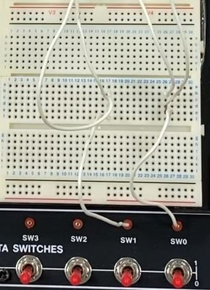
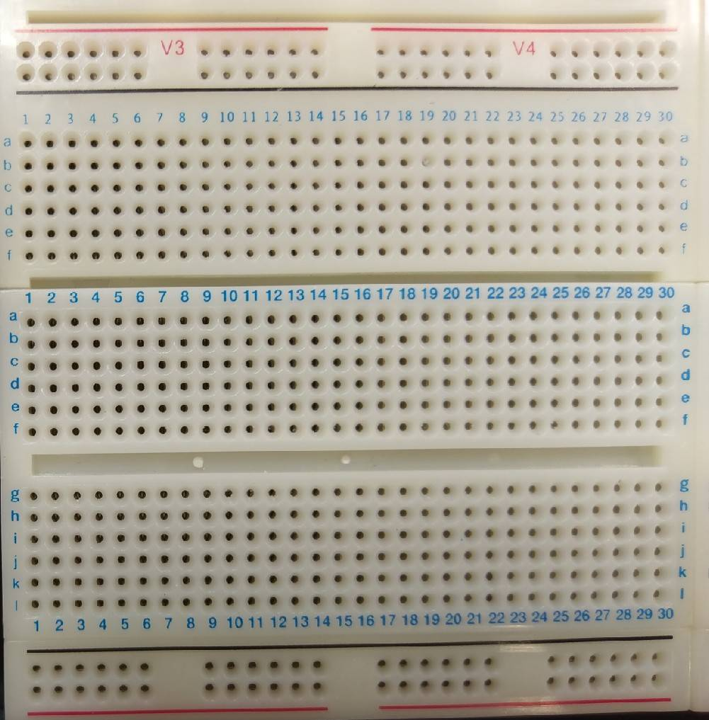
複習&接線技巧 - 接線技巧
A
B
A
B

Slide 10
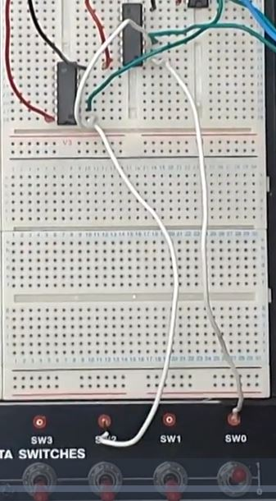
複習&接線技巧 - 接線技巧
A
A
B

Slide 11
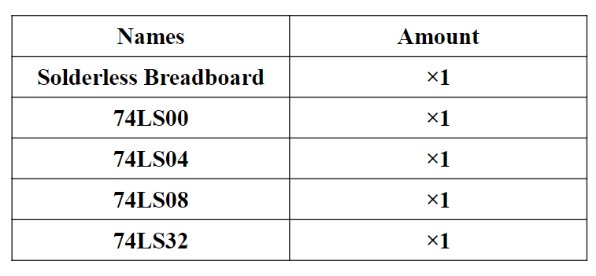
Lab 說明 - Lab Notice

Slide 12
Lab 說明 - Lab 02-1 Boolean Algebra
Given two boolean function, Please
(a) draw the truth table
(b) draw the circuit diagram
(c) implement it on the solderless breadboard.
F₁(A, B) = (A + B)’(A’ + B’)
F₂(A, B) = A’+ AB
Notes:
錯誤：此時不需化簡(已修正)

Slide 13
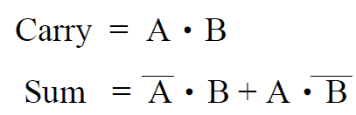
Lab 說明 - Lab 02-2 Half Adder
A half adder (HA) consists of two inputs (A and B) and two outputs (Sum and Carry). “A” denotes the summand and “B” is the addend. Sum and Carry mean the output sum and carry for input “A” and “B”. The truth table and Boolean algebra for the half adder are as follows.
A | B | Sum | Carry
0 | 0 | 0 | 0
0 | 1 | 1 | 0
1 | 0 | 1 | 0
1 | 1 | 0 | 1

Slide 14
Lab 說明 - Lab 02-2 Half Adder
Please
(a) draw the circuit diagram of the half adder according
to the truth table shown in previous page.
(b) implement the circuit on the breadboard.

